Slide 1
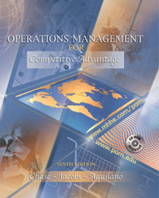

Slide 2
Chapter 9
Supply-Chain Strategy

Slide 3
OBJECTIVES
Supply-Chain Management
Measuring Supply-Chain Performance
Bullwhip Effect
Outsourcing
Value Density
Mass Customization
Notes:
2

Slide 4
What is a Supply-Chain?
Defined
Supply-chain is a term that describes how organizations (suppliers, manufacturers, distributors, and customers) are linked together
Suppliers
Inputs
Suppliers
Service support operations
Transformation
Manufacturing
Local service providers
Localization
Distribution
Customers
Output
Customers
Services
Supply networks
Manufacturing

Slide 5
What is Supply-Chain Management?
Defined
Supply-chain management is a total system approach to managing the entire flow of information, materials, and services from raw-material suppliers through factories and warehouses to the end customer

Slide 6
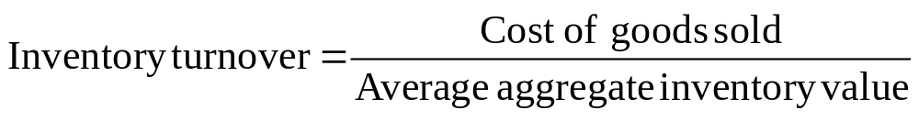
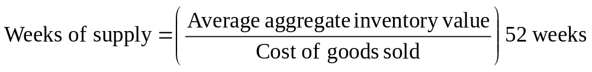
Formulas for Measuring Supply-Chain Performance
One of the most commonly used measures in all of operations management is “Inventory Turnover”
In situations where distribution inventory is dominant, “Weeks of Supply” is preferred and measures how many weeks’ worth of inventory is in the system at a particular time
Notes:
17

Slide 7
Example of Measuring Supply-Chain Performance
Suppose a company’s new annual report claims their costs of goods sold for the year is $160 million and their total average inventory (production materials + work-in-process) is worth $35 million. This company normally has an inventory turn ratio of 10. What is this year’s Inventory Turnover ratio? What does it mean?

Slide 8
Example of Measuring Supply-Chain Performance (Continued)
= $160/$35
= 4.57
Since the company’s normal inventory turnover ration is 10, a drop to 4.57 means that the inventory is not turning over as quickly as it had in the past. Without knowing the industry average of turns for this company it is not possible to comment on how they are competitively doing in the industry, but they now have more inventory relative to their cost of goods sold than before.
Notes:
17

Slide 9

Bullwhip Effect
The magnification of variability in orders in the supply-chain
Retailer’s Orders
Wholesaler’s Orders
Manufacturer’s Orders
Order
Quantity
Order
Quantity
Order
Quantity
Time
Time
Time
A lot of retailers each with little variability in their orders….
…can lead to greater variability for a fewer number of wholesalers, and…
…can lead to even greater variability for a single manufacturer.

Slide 10
Hau Lee’s Concepts of Supply Chain Management
Hau Lee’s approach to supply chain (SC) is one of aligning SC’s with the uncertainties revolving around the supply process side of the SC
A stable supply process has mature technologies and an evolving supply process has rapidly changing technologies
Types of SC’s
  Efficient SC’s
  Risk-Hedging SC’s
  Responsive SC’s
  Agile SC’s
Notes:
7

Slide 11
Hau Lee’s SC Uncertainty Framework
Demand Uncertainty
Low (Functional products)
High (Innovative products)
Low
(Stable
Process)
Efficient SC
Ex.: Grocery
Responsive SC
Ex.: Computers
Supply
Uncertainty
Risk-Hedging SC
Ex.: Hydro-electric power
Agile SC
Ex.: Telecom
High
(Evolving
Process)
Notes:
7

Slide 12
What is Outsourcing?
Defined
Outsourcing is defined as the act of moving a firm’s internal activities and decision responsibility to outside providers

Slide 13
Reasons to Outsource
Organizationally-driven
Improvement-driven
Financially-driven
Revenue-driven
Cost-driven
Employee-driven
Notes:
7

Slide 14
Value Density
Defined
Value density is defined as the value of an item per pound of weight
It is used as an important measure when deciding where items should be stocked geographically and how they should be shipped

Slide 15
Mass Customization
Defined
Mass customization is a term used to describe the ability of a company to deliver highly customized products and services to different customers
The key to mass customization is effectively postponing the tasks of differentiating a product for a specific customer until the latest possible point in the supply-chain network

Slide 16
End of Chapter 9

